Slide 1

STATS 432 Computational Statistics
Chapter 10 – Convergence Diagnostics

Slide 2

10.1 – Overview

Slide 3
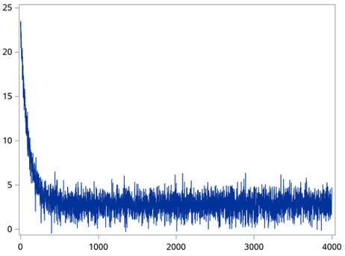
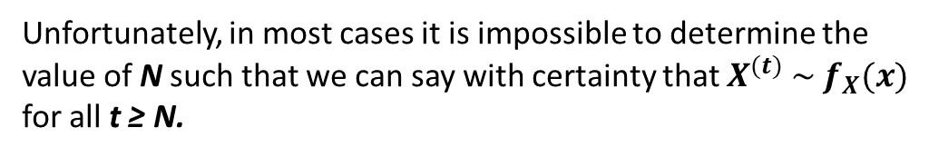


10.1 – Overview:
10.1 - Overview
The Metropolis-Hastings algorithm creates an irreducible, ergodic (positive recurrent and aperiodic) continuous state space Markov chain ${\left\{X^{\left(t\right)}\right\}}_{t=0}^{∞}$ which converges to a target distribution $f_{X}(x)$in the sense that
$$k^{\left(n\right)}\left(x,y\right) →{f(y)} as n→∞$$
After a large number of transitions, observations drawn from the chain will be distributed according to $f_{X}(x)$.
Burn in
$$X^{(t)} \sim f$$
Unfortunately, in most cases it is impossible to determine the value of N such that we can say with certainty that $X^{(t)} \sim f_{X}(x)$
for all t ≥ N.
i.e. its impossible to tell when the chain has converged to the target distribution!
3

Slide 4
10.1 – Overview:
10.1 - Overview
Despite this there are a number of visual and empirical tests that can be performed in order to asses convergence.
These include:
Visual Tests:
Notes:
Time series plots (provide info on convergence & mixing)
Auto-correlation plots (provide info on mixing and iid’ness)
If a chain passes all three of the statistical tests mentioned below, this does not imply convergence.
However, if a chain fails any of the three tests, this implies non-convergence.
Statistical tests are not a substitute for visual plots, because statistical tests do not tell you how efficient the chain is.
Summary Statistics:
Obtaining summary statistics of the post-burn-in values of the chain using the coda package in R. If the target distribution has a particular mean and variance, then the post-burn-in values of the chain should also have a similar mean and variance.
Statistical Tests:
Geweke Time Series Diagnostic
Gelman & Rubin Multiple Sequence Diagnostic
Heidelberger & Welch Diagnostic
4

Slide 5
10.2 – Summary Statistics

Slide 6

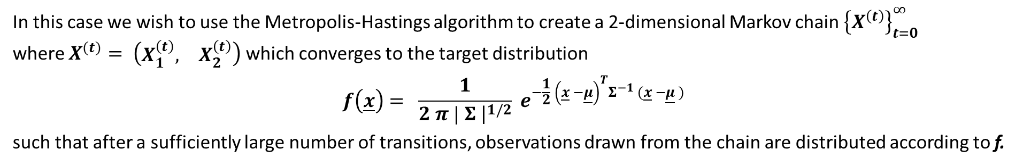
10.2 – Summary Statistics:
10.2 – Summary Statistics
Consider the problem of obtaining a sample of observations from the bivariate normal distribution defined by
$N( \underline{μ} , Σ )$ where $\underline{μ}={\left(3,1\right)}^{T}$ and $Σ= \left[\begin{matrix}1 & −0.5 \\ −0.5 & 2.0\end{matrix}\right]$
In this case we wish to use the Metropolis-Hastings algorithm to create a 2-dimensional Markov chain ${\left\{X^{\left(t\right)}\right\}}_{t=0}^{∞}$ where $X^{(t)}= \left(\begin{matrix}X_{1}^{\left(t\right)}, & X_{2}^{\left(t\right)}\end{matrix}\right)$ which converges to the target distribution
$$f\left(\underline{x}\right)= \frac{1}{2 π | Σ {\left.​\right|}^{1/2}} e^{−\frac{1}{2} {\left(\underline{x} −\underline{μ}\right)}^{T}Σ^{−1} (\underline{x} −\underline{μ} )}$$
such that after a sufficiently large number of transitions, observations drawn from the chain are distributed according to f.
To do so we will use a random walk sampler with normal proposal density:
$$y_{1, t+1} \sim N\left( X_{1}^{\left(t\right)} , σ_{1}^{2} \right) ↔ q_{1}\left(x,y\right) ={\left(2 π{ σ}_{1}^{2}\right)}^{−1/2} e^{−\frac{1}{2} (y− {x) }^{2} / σ_{1}^{2}}$$
$$y_{2, t+1} \sim N\left( X_{2}^{\left(t\right)} , σ_{2}^{2} \right) ↔ q_{2}\left(x,y\right) ={\left(2 π{ σ}_{2}^{2}\right)}^{−1/2} e^{−\frac{1}{2} (y− {x) }^{2} / σ_{2}^{2}}$$
Given the symmetry of $q_{1}\left(x,y\right)$ and $q_{2}\left(x,y\right)$, this implies that the MH acceptance probability simplifies to
$α\left(x,y\right)=min \left( 1 , \frac{f\left(y\right)}{f\left(x\right)} \right)$
6
Associated Code = 10 - Bivariate Normal Example (Convergence Tests)

Slide 7
10.2 – Summary Statistics:
10.2 – Summary Statistics
Consider the problem of obtaining a sample of observations from the bivariate normal distribution defined by
$N( \underline{μ} , Σ )$ where $\underline{μ}={\left(3,1\right)}^{T}$ and $Σ= \left[\begin{matrix}1 & −0.5 \\ −0.5 & 2.0\end{matrix}\right]$
In this case we wish to use the Metropolis-Hastings algorithm to create a 2-dimensional Markov chain ${\left\{X^{\left(t\right)}\right\}}_{t=0}^{∞}$ where $X^{(t)}= \left(\begin{matrix}X_{1}^{\left(t\right)}, & X_{2}^{\left(t\right)}\end{matrix}\right)$ which converges to the target distribution
$$f\left(\underline{x}\right)= \frac{1}{2 π | Σ {\left.​\right|}^{1/2}} e^{−\frac{1}{2} {\left(\underline{x} −\underline{μ}\right)}^{T}Σ^{−1} (\underline{x} −\underline{μ} )}$$
such that after a sufficiently large number of transitions, observations drawn from the chain are distributed according to f.
To do so we will use a random walk sampler with normal proposal density:
$$y_{1, t+1} \sim N\left( X_{1}^{\left(t\right)} , σ_{1}^{2} \right) ↔ q_{1}\left(x,y\right) ={\left(2 π{ σ}_{1}^{2}\right)}^{−1/2} e^{−\frac{1}{2} (y− {x) }^{2} / σ_{1}^{2}}$$
$$y_{2, t+1} \sim N\left( X_{2}^{\left(t\right)} , σ_{2}^{2} \right) ↔ q_{2}\left(x,y\right) ={\left(2 π{ σ}_{2}^{2}\right)}^{−1/2} e^{−\frac{1}{2} (y− {x) }^{2} / σ_{2}^{2}}$$
Given the symmetry of $q_{1}\left(x,y\right)$ and $q_{2}\left(x,y\right)$, this implies that the MH acceptance probability simplifies to
$α\left(x,y\right)=min \left( 1 , \frac{f\left(y\right)}{f\left(x\right)} \right)$
7
Associated Code = 10 - Bivariate Normal Example (Convergence Tests)

Slide 8
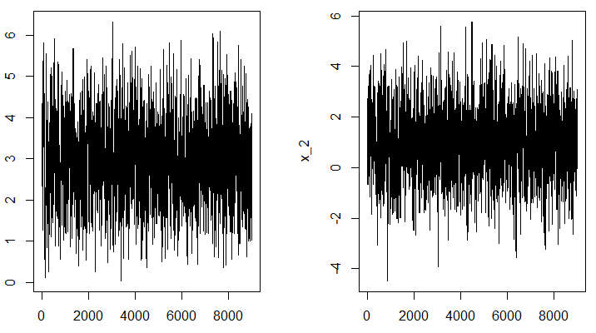
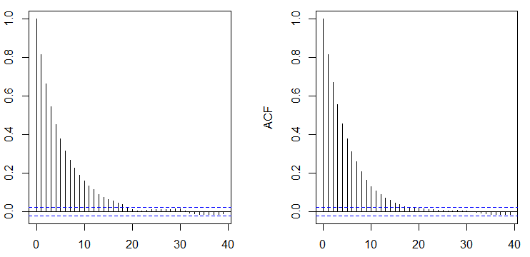

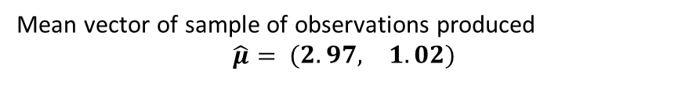
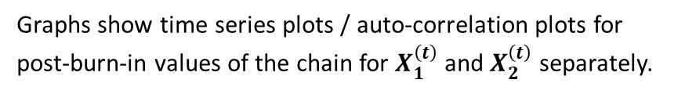
10.2 – Summary Statistics:
10.2 – Summary Statistics
Burn-in
Post Burn-in
Setting $σ_{1}^{2}=1$ , $σ_{2}^{2}=2$ and n = 1,000 + 9,000
Acceptance rate = 53%
X₁
X₂
Graphs show time series plots / auto-correlation plots for post-burn-in values of the chain for $X_{1}^{\left(t\right)}$ and $X_{2}^{\left(t\right)}$ separately.
Time series plots show quick convergence and speedy traversing of the state space (good mixing).
Auto-correlation plots show low correlation for high lag values
Mean vector of sample of observations produced
$$\hat{μ}= \left(\begin{matrix}2.97, & 1.02\end{matrix}\right)$$
X₁
X₂
Covariance matrix of sample of observations produced
$$\hat{Σ}= \left[\begin{matrix} 0.97 & −0.45 \\ −0.45 & 1.90\end{matrix}\right]$$
Sample produced is a decent representation of target distribution.
8
Associated Code = 10 - Bivariate Normal Example (Convergence Tests)

Slide 9
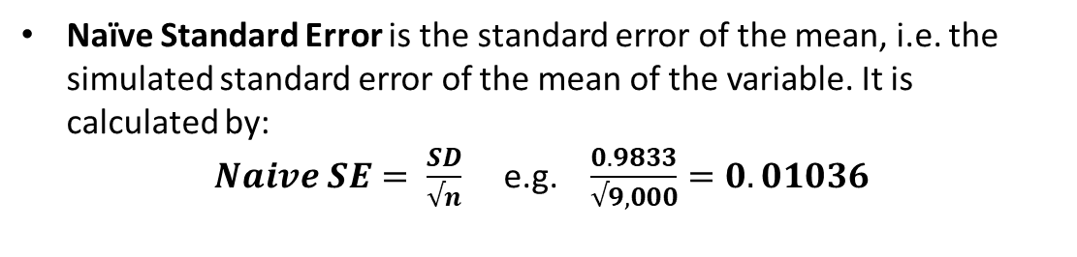
10.2 – Summary Statistics:
10.2 – Summary Statistics
# 2.1i - Convert the chain into an MCMC object, using the coda package function
library(coda)
post_burn0 <- mcmc(post_burn)
# 2.1j - Produce summary statistics
summary(post_burn0)
Coda package summary statistics gives means, standard deviation and quantiles for each dimension of the sample of observations produced.
Iterations = 1:9000
Thinning interval = 1
Number of chains = 1
Sample size per chain = 9000
1. Empirical mean and standard deviation for each variable plus standard error of the mean:
Mean SD Naive SE Time-series SE
[1,] 2.97 0.9833 0.01036 0.03257
[2,] 1.02 1.3793 0.01454 0.04637
2. Quantiles for each variable:
2.5% 25% 50% 75% 97.5%
var1 1.103 2.2877 2.967 3.627 4.964
var2 -1.648 0.0915 1.006 1.980 3.689
Naïve Standard Error is the standard error of the mean, i.e. the simulated standard error of the mean of the variable. It is calculated by:
$Naive SE= \frac{SD}{√n}$ e.g. $\frac{0.9833}{√9,000}=0.01036$
Time Series Standard Error adjusts the Naïve SE for auto-correlation, i.e. accounts for the fact that sequential elements of the chain are dependent.
9
Associated Code = 10 - Bivariate Normal Example (Convergence Tests)

Slide 10
10.3 – Geweke Time Series Diagnostics

Slide 11

10.3 – Geweke Diagnostic:
10.3 – Geweke Diagnostic
The Geweke Time Series Diagnostic can be explained informally as follows…
Take two non-overlapping windows of the chain
The default is to take the first 10% of the chain (after burn-in) and the last 50% of the chain (after burn-in)
i.e. if you have 10,000 post-burn-in values, then the following windows are formed
${\underline{x}}_{1}= {\left\{X^{\left(t\right)}\right\}}_{t=Burnin+1}^{Burnin + 1,000}$ and ${\underline{x}}_{2}= {\left\{X^{\left(t\right)}\right\}}_{t=Burnin+5,001}^{Burnin + 10,000}$
Conduct a difference of two means test on the values in each window
The Geweke Diagnostic then performs a difference of two means test to determine whether
the values in each window arise from the same distribution.
If the Geweke Diagnostic provides evidence against the null hypothesis that the values in the two windows have equal means, this suggests that the first chain (or possibly both) have not yet converged to the target distribution.
In such instances, the first thing to try is taking a larger burn-in then repeating the test. If the chain still fails the Geweke test with a larger burn-in period, there may be something wrong with your algorithm.
11

Slide 12
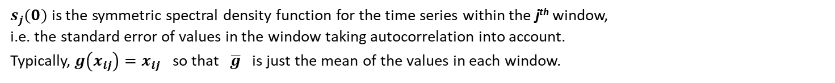
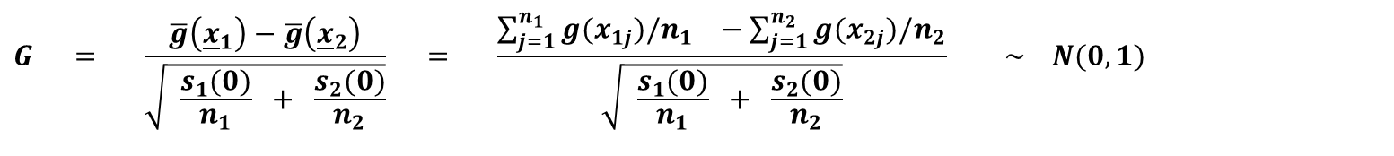
10.3 – Geweke Diagnostic:
10.3 – Geweke Diagnostic
More formally the Geweke Time Series Diagnostic proceeds according to the following steps:
Take two non-overlapping windows of the post burn in chain. Call the values in these windows ${\underline{x}}_{1}$ and ${\underline{x}}_{2}$. ${\underline{x}}_{1}$ consists of $n_{1}$ values from early in the chain and ${\underline{x}}_{2}$ consists of $n_{2}$ values from the end of the chain.
The Geweke Diagnostic tests between the following null and alternative hypotheses: H₀ : The chain values in the two windows arise from the same distribution H₁ : The chain values in the two windows do not arise from the same distribution
The test statistic G provides a measure of evidence against the null hypothesis
$$G = \frac{\overline{g}\left({\underline{x}}_{1}\right)−\overline{g}\left({\underline{x}}_{2}\right)}{\sqrt{ \frac{s_{1}(0)}{n_{1}} + \frac{s_{2}(0)}{n_{2}}}} = \frac{\sum_{j=1}^{n_{1}}{g(x_{1j})/n_{1}} −\sum_{j=1}^{n_{2}}{g(x_{2j})/n_{2}}}{\sqrt{ \frac{s_{1}(0)}{n_{1}} + \frac{s_{2}(0)}{n_{2}}}} \sim N(0,1)$$
$s_{j}(0)$ is the symmetric spectral density function for the time series within the j^{th} window, i.e. the standard error of values in the window taking autocorrelation into account.
Typically, $g\left(x_{ij}\right)=x_{ij}$ so that $\overline{g}$ is just the mean of the values in each window.
Since G follows a standard normal distribution, values of $| G |$ greater than 2 are usually taken as an indication of non-convergence
12

Slide 13
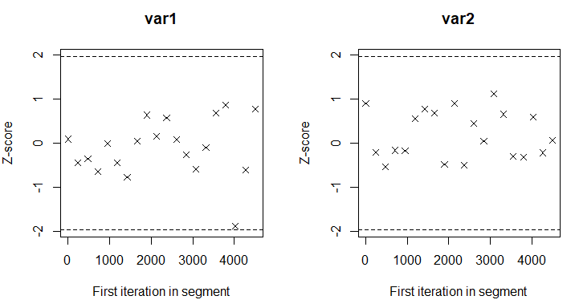
10.3 – Geweke Diagnostic:
10.3 – Geweke Diagnostic
# 4.1a - Performing the Geweke test
geweke.diag(post_burn0)
# 4.1b - Creating Geweke plots
geweke.plot(post_burn0)
Fraction in 1st window = 0.1
Fraction in 2nd window = 0.5
var1 var2
0.08761 0.89868
Z-scores in the example of the Bivariate Normal are both less than 2 in absolute value. => No evidence against the null hypothesis that the values in the two windows are from the same distribution.
Geweke plot function calculates the value of the Geweke Diagnostic with successively more and more points removed from the beginning of the chain. However, it never removes more than half of the chain (otherwise the chain cannot satisfy the asymptotic conditions required for the diagnostic).
The vast majority of points have z-scores within the interval [-2,2], showing no evidence against convergence.
13
Associated Code = 10 - Bivariate Normal Example (Convergence Tests)

Slide 14
10.3 – Geweke Diagnostic:
10.3 – Geweke Diagnostic
Var1
Var2
4
4
2
2
Z-Score
Z-Score
0
0
-2
-2
-4
-4
1st Iteration in segment
1st Iteration in segment
A Geweke plot like this suggests that this first variable needs a longer burn-in to converge to the target distribution.
A Geweke plot like this suggests that this second variable is not converging to the target distribution
For a multi-dimensional chain it is possible for one variable to converge and another not to converge.
14

Slide 15
10.4 – Gelman & Rubin Multiple Sequence Diagnostic

Slide 16
10.4a – Gelman & Rubin Diagnostic:
10.4 – Gelman & Rubin Diagnostic
The Gelman & Rubin Multiple Sequence Diagnostic uses the fact that the Markov chain produced within the Metropolis-Hastings algorithm should (eventually) reach the target distribution irrespective of its starting state.
The idea is that if (identically constructed) chains with different starting values have different variances in their tails, then at least one of those chains has not converged to the target distribution. As such, a larger burn-in or steps to speed convergence may be required.
The Gelman & Rubin Diagnostic proceeds according to the following steps:
Construct $m≥2$ chains of length $2n$ with over-dispersed starting values i.e. choose starting values for the chains that are widely spread out across the target distribution so that each chain initially explores different parts of the state space.
Disregard the first n elements of each chain (i.e. keep the last 50% of values in each chain)
Using the remaining n values from each chain calculate the Potential Scale Reduction Factor (PSRF). As a rule of thumb, if PSRF > 1.2 we take this as an indication that (at least one of) the chains has not converged.
Basically, we create $m≥2$chains with over-dispersed starting values.
We then calculate the PSRF (easily done in R). If this is greater than 1.2 in value, we take this as evidence of non-convergence.
16

Slide 17
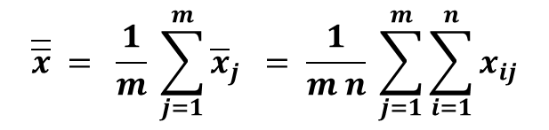
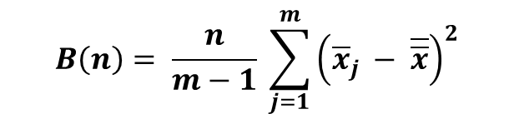
10.4b – How Does the G&R Diagnostic Work:
10.4 – Gelman & Rubin Diagnostic
Within Chain Variance:
$$W(n)= \frac{1}{m} \sum_{j=1}^{m}{S_{j}^{2}} S_{j}^{2}= \frac{1}{n−1} \sum_{i=1}^{n}{{\left(x_{ij} − {\overline{x}}_{j}\right)}^{2}}$$
Let
where
Since $S_{j}^{2}$ is just the (sample) variance of the tail of chain j => W is the average variance of the m truncated chains.
Hence, W is an estimate of the variance of the target distribution.
If any of the m chains have not fully converged W will underestimate the variance of the target distribution since (at least one of) the chains will not have sufficiently explored the entire state space of the target distribution.
Between Chain Variance:
$$B\left(n\right)= \frac{n}{m−1} \sum_{j=1}^{m}{{\left({\overline{x}}_{j} − \overline{\overline{x}}\right)}^{2}}$$
$$\overline{\overline{x}} = \frac{1}{m} \sum_{j=1}^{m}{{\overline{x}}_{j}} = \frac{1}{m n} \sum_{j=1}^{m}{\sum_{i=1}^{n}{x_{ij}}}$$
Let
where
B is the variance of chain means multiplied by a factor of n (because each truncated chain has n values). B is also an estimate of the variance of the target distribution.
17

Slide 18


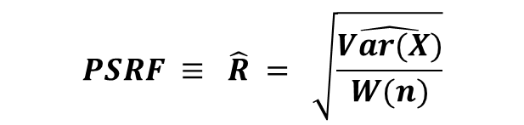
10.4b – How Does the G&R Diagnostic Work:
10.4 – Gelman & Rubin Diagnostic
Weighted Average Estimate of the Variance of the Target Distribution:
The variance of the target distribution can be estimated as a weighted average of W(n) and B(n) such that
$$\hat{Var(X)} = \left(1 − \frac{1}{n}\right) W\left(n\right) + \frac{1}{n} B(n)$$
Due to the (purposeful) over-dispersion of starting values, if the chains have not converged, then this will overestimate the variance of the target distribution.
Potential Scale Reduction Factor (PSRF):
$$PSRF ≡ \hat{R} = \sqrt{\frac{\hat{Var(X)}}{W(n)}}$$
Overestimates variance of target distribution if chains have not converged.
$$⇒ PSRF ≡ \hat{R} → 1^{+}$$
As $n→∞$ i.e. as the chains converge to the target distribution.
Underestimates variance of target distribution if chains have not converged.
As a rule of thumb, if $PSRF ≡ \hat{R} >1.2$ we take this as an indication that (at least one of) the chains has not converged.
If the chain is multi-dimensional, the PSRF must be calculated for each variable. Chain length should be sufficiently long so that $PSRF ≡ \hat{R}≤1.2$ for all variables.
18

Slide 19
10.4b – How Does the G&R Diagnostic Work:
10.4 – Gelman & Rubin Diagnostic
Weighted Average Estimate of the Variance of the Target Distribution:
The variance of the target distribution can be estimated as a weighted average of W(n) and B(n) such that
$$\hat{Var(X)} = \left(1 − \frac{1}{n}\right) W\left(n\right) + \frac{1}{n} B(n)$$
Due to the (purposeful) over-dispersion of starting values, if the chains have not converged, then this will overestimate the variance of the target distribution.
Potential Scale Reduction Factor (PSRF):
$$PSRF ≡ \hat{R} = \sqrt{\frac{\hat{Var(X)}}{W(n)}}$$
Overestimates variance of target distribution if chains have not converged.
$$⇒ PSRF ≡ \hat{R} → 1^{+}$$
As $n→∞$ i.e. as the chains converge to the target distribution.
Underestimates variance of target distribution if chains have not converged.
As a rule of thumb, if $PSRF ≡ \hat{R} >1.2$ we take this as an indication that (at least one of) the chains has not converged.
Basically, we create $m≥2$chains with over-dispersed starting values.
We then calculate the PSRF (easily done in R). If this is greater than 1.2 in value, we take this as evidence of non-convergence
19

Slide 20
10.4c – Bivariate Normal Example:
10.4 – Gelman & Rubin Diagnostic
# 5.1a - Producing several different chains and specifying them to be mcmc objects
set.seed(12345)
MHresult1 <- MHbvn(burnin + mcmc, a=0 , b=0)
chain1 <- mcmc( MHresult1$xbvn )
set.seed(12345)
MHresult2 <- MHbvn(burnin + mcmc, a=-5 , b=-5)
chain2 <- mcmc( MHresult2$xbvn )
set.seed(12345)
MHresult3 <- MHbvn(burnin + mcmc, a=10 , b=10)
chain3 <- mcmc( MHresult3$xbvn )
set.seed(12345)
MHresult4 <- MHbvn(burnin + mcmc, a=-20 , b=-20)
chain4 <- mcmc( MHresult4$xbvn )
# 5.1b - Combining the chains into an mcmc.list
gel_rub_list <- mcmc.list( list(chain1, chain2, chain3, chain4 ) )
# 5.1c - Conducting the Gelman & Rubin diagnostic test
gelman.diag(gel_rub_list)
Potential scale reduction factors:
Point est. Upper C.I.
[1,] 1 1
[2,] 1 1
Multivariate psrf
PSRF is estimated with uncertainty due to finite chain length.
Gelman.diag() function gives: - a (median) point estimate for the PSRF - a 97.5% quantile estimate (i.e. the upper limit of a 95% CI)
In this example both the point and upper estimate are equal to 1 for both variables. Hence, there is no evidence to suggest that the chains have not converged.
20
Associated Code = 10 - Bivariate Normal Example (Convergence Tests)

Slide 21
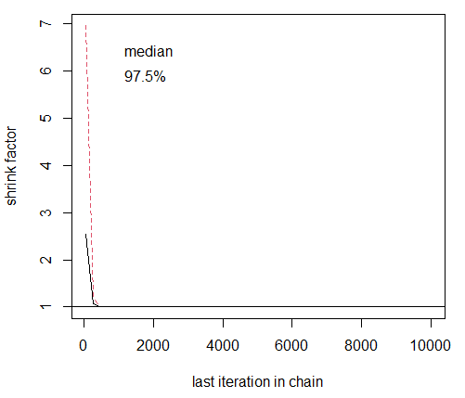
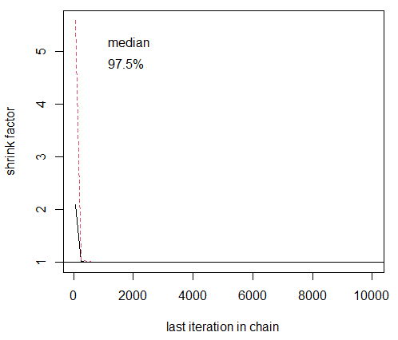
10.4c – Bivariate Normal Example:
10.4 – Gelman & Rubin Diagnostic
# 5.1d - Producing Gelman-Rubin plots gelman.plot(gel_rub_list)
X₁
The gelman.plot() function calculates the value of the PSRF with different numbers of points included at the beginning of the chain. Note that this is the opposite of the Geweke plot.
The adjacent plots from the bivariate normal example show no evidence against the assumption that the chains have converged.
If early values are included, then $\hat{Var(X)}>W ⇒\hat{R}>1$ because the chains have not yet converged.
X₂
However, if early values are excluded, then $\hat{Var(X)} ≈W ⇒\hat{R} ≈1$ which suggests (but does not prove) that the chains have converged.
21
Associated Code = 10 - Bivariate Normal Example (Convergence Tests)

Slide 22
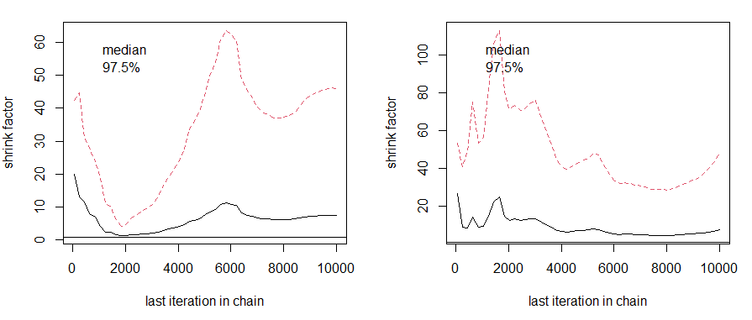
10.4c – Bivariate Normal Example:
10.4 – Gelman & Rubin Diagnostic
X₁
X₂
A Gelman & Rubin plot like the one above would indicate that the chain has not converged to the target distribution. Possible remedies include: - Increasing the burn-in. - Modifying the proposal density (or its width) to speed convergence. - Check whether something is wrong in your algorithm.
22

Slide 23
10.5 – Heidelberger & Welch Diagnostic

Slide 24



10.5a – Heidelberger & Welch Diagnostic:
10.5 – Heidelberger & Welch Diagnostic
The Herdelberger & Welch Diagnostic has two parts:
Part 1: Stationarity Test Calculates a (Cramer-von-Mises) test statistic to accept or reject the null hypothesis that the Markov chain is from a stationary (and hence limiting) distribution.
Part 2: Halfwidth Test
If the chain passes the stationarity test, a halfwidth test is performed.
Part 1: Stationarity Test
Generate a chain of n iterations and define an $α$-level.
Calculate the test statistic on the whole chain. Accept or reject the null hypothesis that the chain is from a stationary distribution.
If null hypothesis is rejected, discard the first 10% of the chain. Recalculate the test statistic and accept or reject the null hypothesis.
$$⋮$$
$$⋮$$
$$⋮$$
Repeat until the null hypothesis is accepted or 50% of the chain is discarded. If the test still rejects the null hypothesis the chain fails the test implying that it has not converged. The chain must be run for longer.
24

Slide 25
10.5a – Heidelberger & Welch Diagnostic:
10.5 – Heidelberger & Welch Diagnostic
The Herdelberger & Welch Diagnostic has two parts:
Part 1: Stationarity Test Calculates a (Cramer-von-Mises) test statistic to accept or reject the null hypothesis that the Markov chain is from a stationary (and hence limiting) distribution.
Part 2: Halfwidth Test
If the chain passes the stationarity test, a halfwidth test is performed.
Part 2: Halfwidth Test
If the chain passes the stationarity test, then take the part of the chain not discarded and run the halfwidth test.
The halfwidth test calculates half the width of the $\left(1−α\right)\%$ credible interval (the Bayesian version of a confidence interval) around the mean.
If $\frac{halfwidth}{mean}<ε$ then the chain passes the test. Otherwise a longer chain is required.
The default values in R are $α=0.05$ and $ε=0.1$.
25

Slide 26
10.5a – Heidelberger & Welch Diagnostic:
10.5 – Heidelberger & Welch Diagnostic
The Herdelberger & Welch Diagnostic has two parts:
Part 1: Stationarity Test Calculates a (Cramer-von-Mises) test statistic to accept or reject the null hypothesis that the Markov chain is from a stationary (and hence limiting) distribution.
Part 2: Halfwidth Test
If the chain passes the stationarity test, a halfwidth test is performed.
WARNING:
If the chain fails the test, then we need to extend the chain and run the test again.
However, this incurs the problem of sequential testing (the chain could end up passing the test just by chance).
Heidelberger & Welch suggest increasing the length of the chain by a factor of 1.5 each time so that there is a reasonably large proportion of new values in the chain.
26

Slide 27
10.5c – Bivariate Normal Example:
10.5 – Heidelberger & Welch Diagnostic
# 6.1a - Converting the MHresult$xbvn chain to an mcmc object (Heidelberger & # Welch test must be run on the whole chain) heidelchain <- mcmc(MHresult$xbvn)
# 6.1b - Conducting the Heidelberger & Welch diagnostic test heidel.diag(heidelchain, eps = 0.1, pvalue = 0.05)
The chain we produced in the bivariate normal example passes both the stationarity test and the halfwidth test.
No evidence that the chain has not converged to the target distribution.
Stationarity start p-value
test iteration
var1 passed 1 0.435
var2 passed 1 0.453
Halfwidth Mean Halfwidth
test
Var1 passed 2.99 0.0624
var2 passed 0.98 0.0862
27
Associated Code = 10 - Bivariate Normal Example (Convergence Tests)

Slide 28
10.5d – Conclusion:
10.5 – Heidelberger & Welch Diagnostic
Given that…
The time series plots suggests convergence.
The auto-correlation plots show low levels of correlation for high lags.
The sample of observation produced have a mean vector and covariance matrix close to the desired values.
The chain passes the Geweke test.
The chain passes the Gelman & Rubin test.
The chain passes the Heidelberger & Welch test.
… there is no evidence to suggest that the chain hasn’t converged.
Still we can’t be 100% certain that it has converged! Good topic for a PhD thesis?
At a guess, the rate of convergence to the stationary distribution will depend geometrically on the eigenvalues of the transition kernel viewed as an operator over the space of distributions.
28
Associated Code = 10 - Bivariate Normal Example (Convergence Tests)

